Slide 1
AI Chatbots for Travel: Enhancing the Traveler Experience Presenter: Tanya Jindal kajal puniya sumit yadav

Slide 2
What are Travel Chatbots? 1.AI Technology Leveraging AI to provide 24/7 support and personalized recommendations. 2.Travel Assistance Offering effective support and entertainment to travelers. 3.Personalization Providing tailored recommendations and assistance throughout the journey.

Slide 3
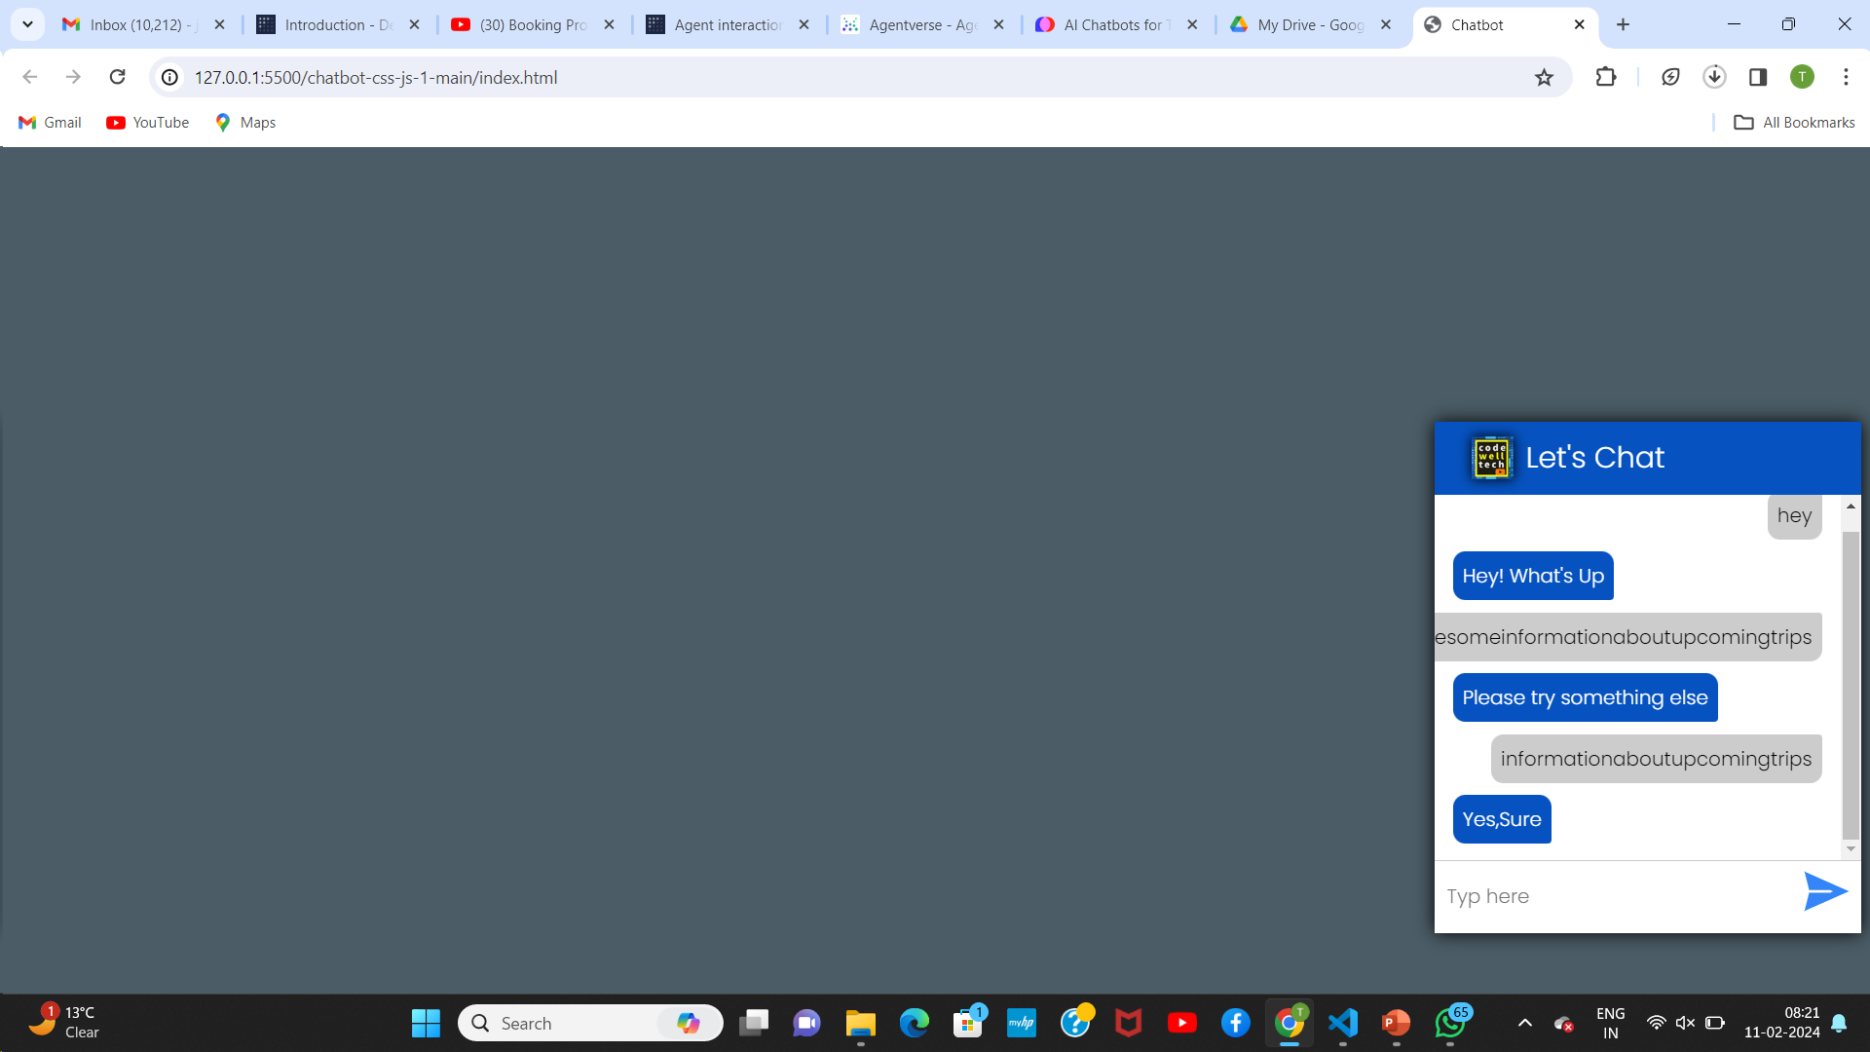

Slide 4
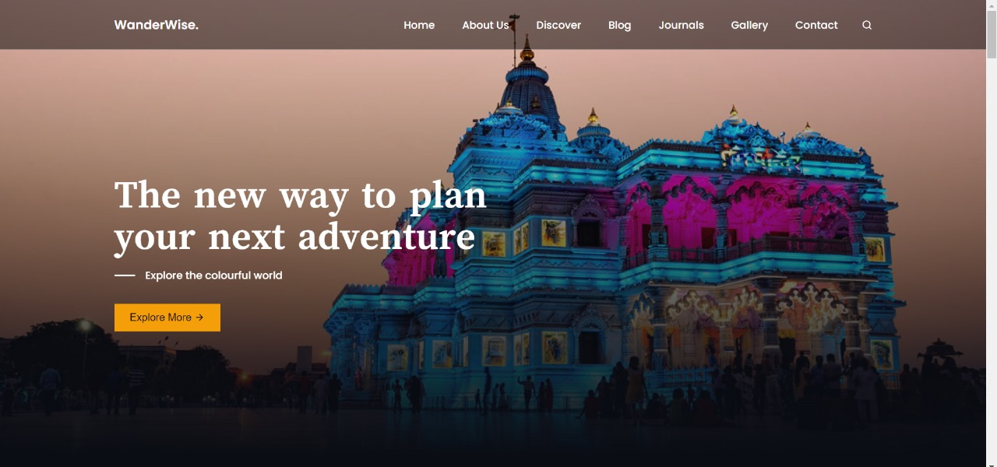

Slide 5


Slide 6
